Slide 1

Python exercise 3

Slide 2
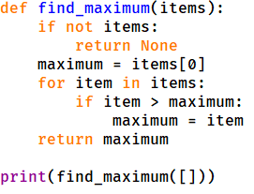
Question 1.1
Fill the blank place with missing code. The program define a function, which takes a list as argument, all items are numbers. The function find and return the maximum number in the list.

Slide 3
Question 1.2
Fill the blank place with missing code. The program define a function, which takes a list as argument, all items are numbers. The function find and return the maximum number in the list.

Slide 4
Question 1
answer.

Slide 5
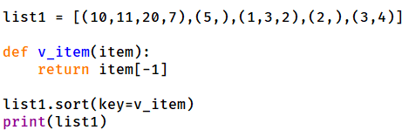
Question 2.1
Fill the blank place with missing code. The program sort a list. The list has items of tuple, and sort according to the last item of tuples.

Slide 6
Question 2.2
Fill the blank place with missing code. The program sort a list. The list has items of tuple, and sort according to the last item of tuples.

Slide 7
Question 2
answer.

Slide 8
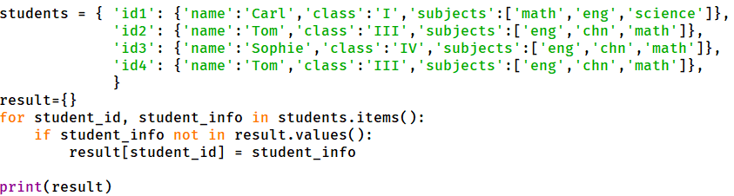
Question 3.1
Fill the blank place with missing code. The program search the dict, and find if any value duplicate, then drop the duplicate values.

Slide 9
Question 3
answer.

Slide 10
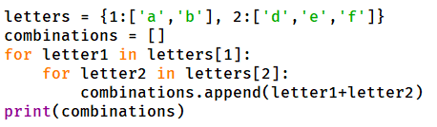
Question 4.1
Fill the blank place with missing code. The dict has 2 key:value paire, each value is a list of letters. Now take the 2 lists of letters and make combinations: first letter from 1st list, second letter from 2nd list. Generate all possibly combinations.

Slide 11
Question 4
answer.

Slide 12
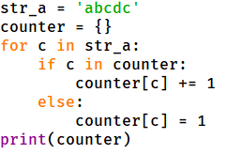
Question 5.1
Fill the blank place with missing code. The program makes a dict, from a string. The keys of the dict are characters in the string, the values of the dict are how many times the character appeared in the string.

Slide 13
Question 5
answer.

